Slide 1
WEB BANK

Slide 2
introduction
This bank application management system is an online software designed in the java programming language for the purpose of effective online banking system​
It mainly aims at making the bank system easily accessible from anywhere and improving and enhancing the running banking process​
The use of this application, bank customers don’t need to go bank enquiry regarding their balance or to transfer to others​

Slide 3


Account type
Using this application user can manage following account type​
Savings account​
Current account​
​

Slide 4

Registration​ ​
It asks for the details of the customer​

Slide 5

Log in
After registration user should login in to the account
After log in user can access this features like
Transaction details
Updates
Complaints
View Transactions

Slide 6



Transaction​
Deposit​
withdrawal​
transfer money​

Slide 7

View transaction​
This is used to see all the transactions​ ​

Slide 8

Update credentials
When the user wants to change his/her details then this update credentials will help us

Slide 9

Complaints​
It notes the complaints given by the customer​

Slide 10
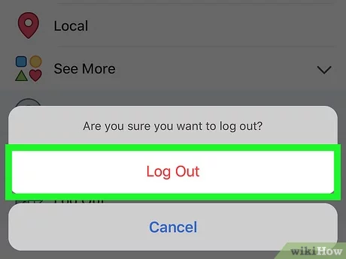
Log out
It is safe to log out when your work is done

Slide 11

Benefits​
This application is to provide a secure system. Our system is password protected​
And it only allows authorized user to access various functions available in the ​

Slide 12
Conclusion​
This application we can access the bank through our mobiles from anywhere. And can access all the futures of the bank easily​

Slide 13
Thank you

